Slide 1
MRI Brain Tumor Classification
Karthik Raj

Slide 2
Significance
Based on 255 uninterrupted eight-hour workdays per year, radiologists are needing to review one image every three to four seconds to meet workload demands. (2015)
Overall workload per radiologist is increasing as
MRI and CT scans are becoming more prevalent (2021)
Increase in complexity of information gleaned from scans (2021)
Increasing cases of burnout amongst diagnostic radiologists (2021)
Potential for deep learning to mitigate these issues

Slide 3
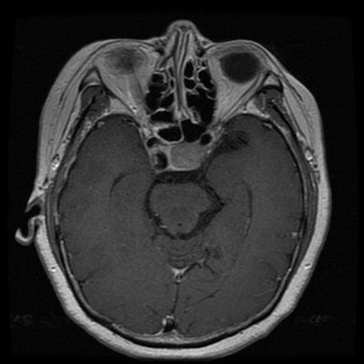
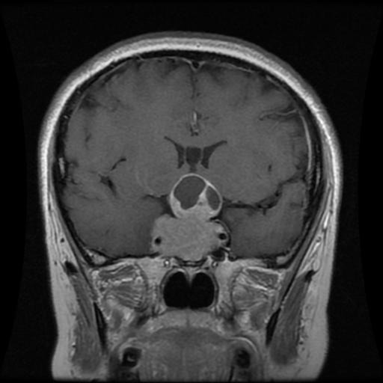
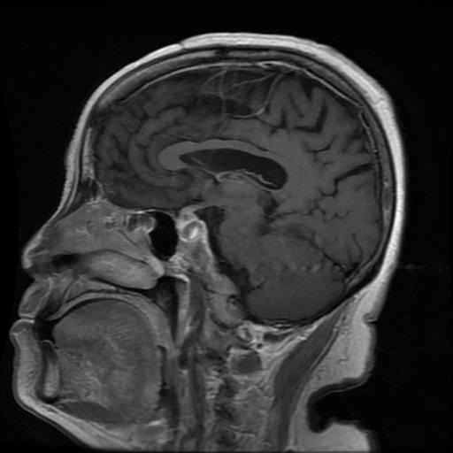
General Characteristics of Dataset
Tumor associated classes are mostly 512 by 512
Non-tumor class has randomly sized images
Scans are taken at different orientations
Axial
Coronal
Sagittal

Slide 4
Dataset Breakdown
Training: 5712 Images -> Split into ⅔ Training & ⅓ Validation
Glioma | Meningioma | Pituitary | No Tumor
1321 | 1339 | 1457 | 1595
Testing: 1311 Images
Glioma | Meningioma | Pituitary | No Tumor
300 | 306 | 300 | 405
Goal: Accurately classify an MRI Brain image into one of these 4 classes
Tumor classes vary based on location in the brain
Notes:
Fairly even distribution of images amongst the classes

Slide 5
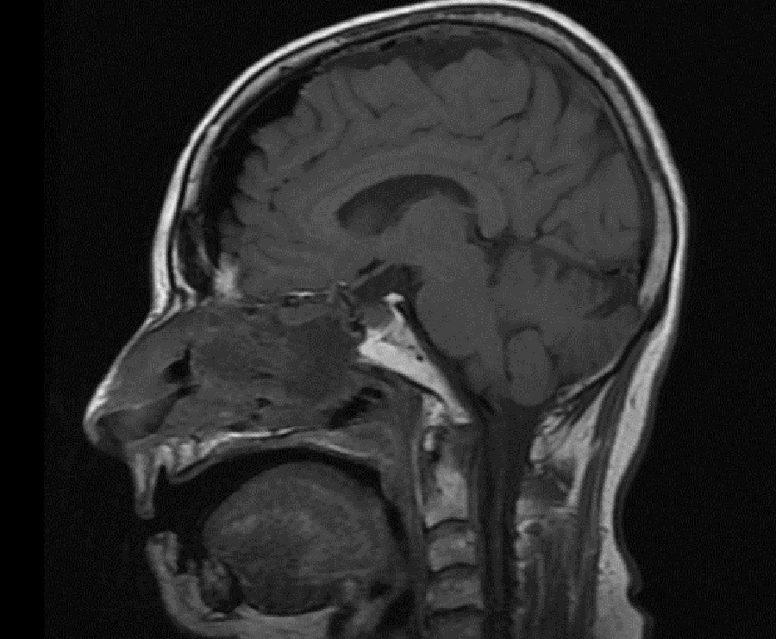

Data Processing Walkthrough
Original Image: (741, 900, 3)
Grayscale Image: (741, 900)
Notes:
Convert all images to grayscale
Apply a binary mask to identify largest contour distinguishing brain from background
Identify this region of interest and crop to it
Resize all images back to 256 by 256
Better than resizing to 512 by 512 because reduces GPU burden for storing image tensors
Also, was generating comparable quality models with this image size
Just add images for these steps starting from original image to contour

Slide 6
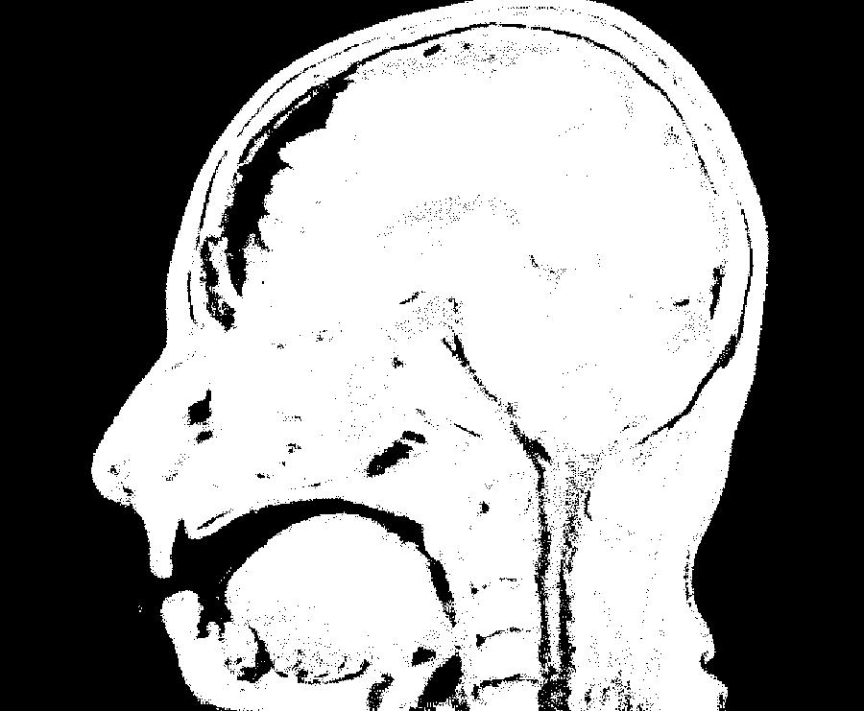
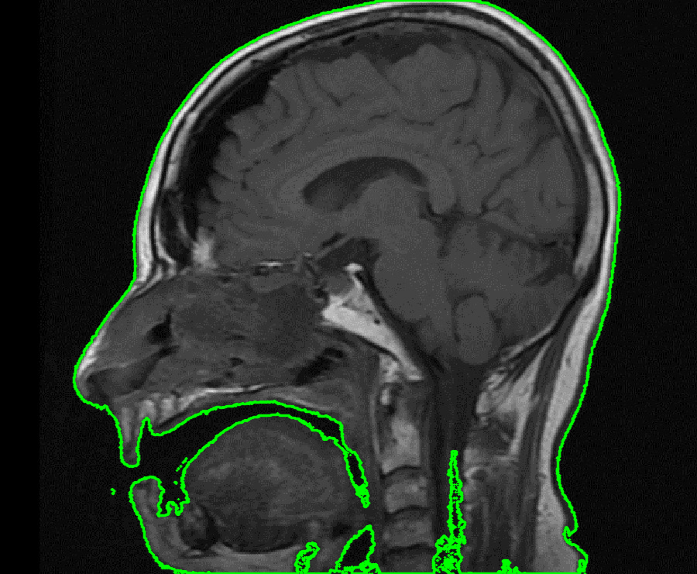
Data Processing Walkthrough
Apply Binary Mask:
If pixel intensity < 30, set pixel to 0 (black)
Else: set pixel to 255 (white)
Draw largest contour on ROI

Slide 7
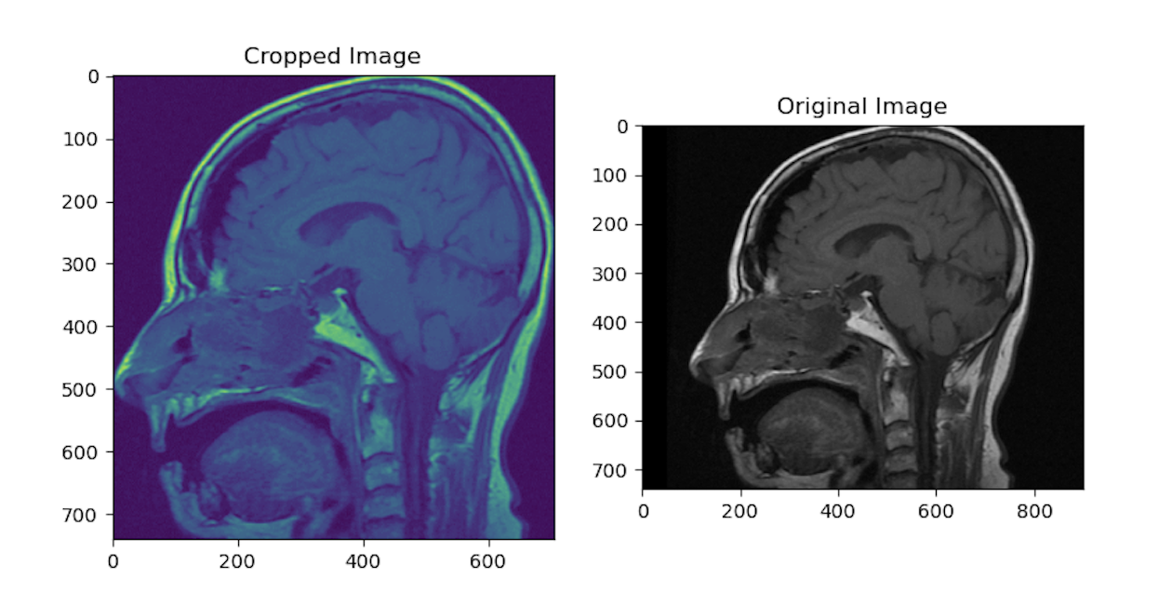
Data Processing Walkthrough
Cropping to ROI

Slide 8
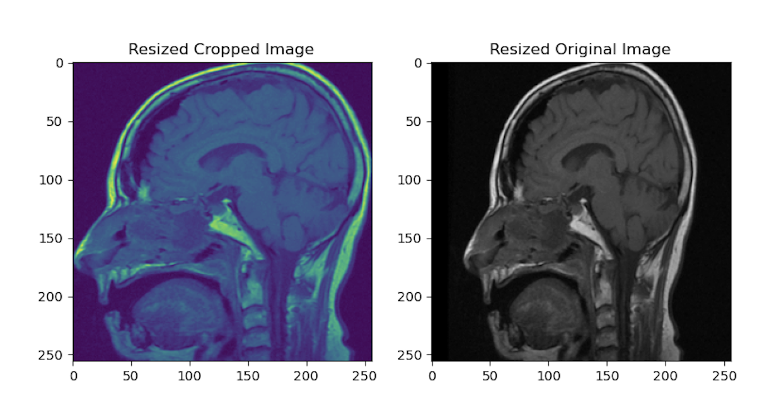
Data Processing Walkthrough
Cropping images to (256,256) & Removed Extraneous Image Background

Slide 9
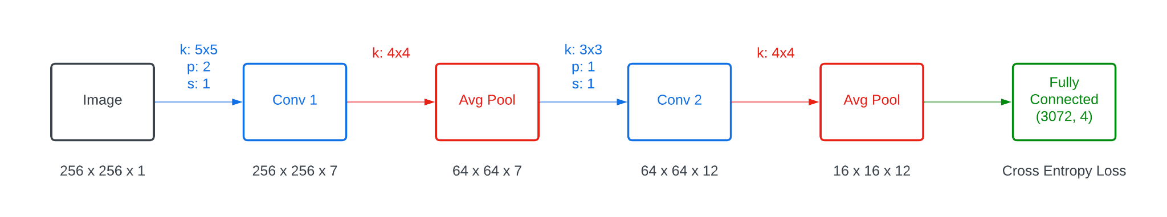
Convolutional Neural Network
Used Batch Normalization & ReLU as the Activation Function throughout Convolution Layers

Slide 10
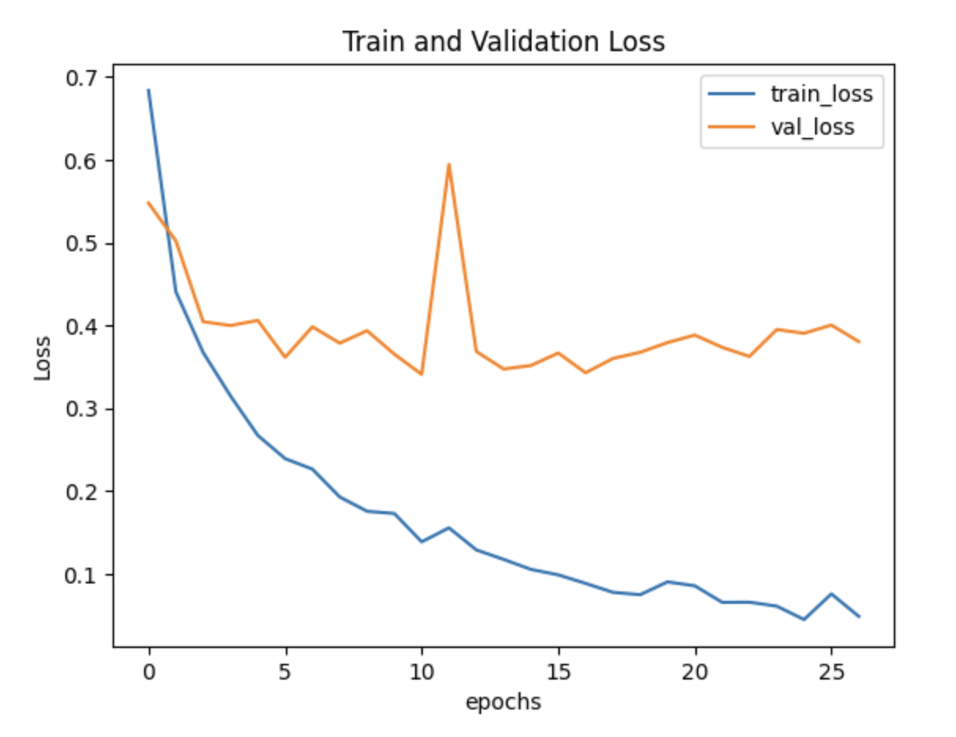
(⅔) Training & (⅓) Validation

Slide 11
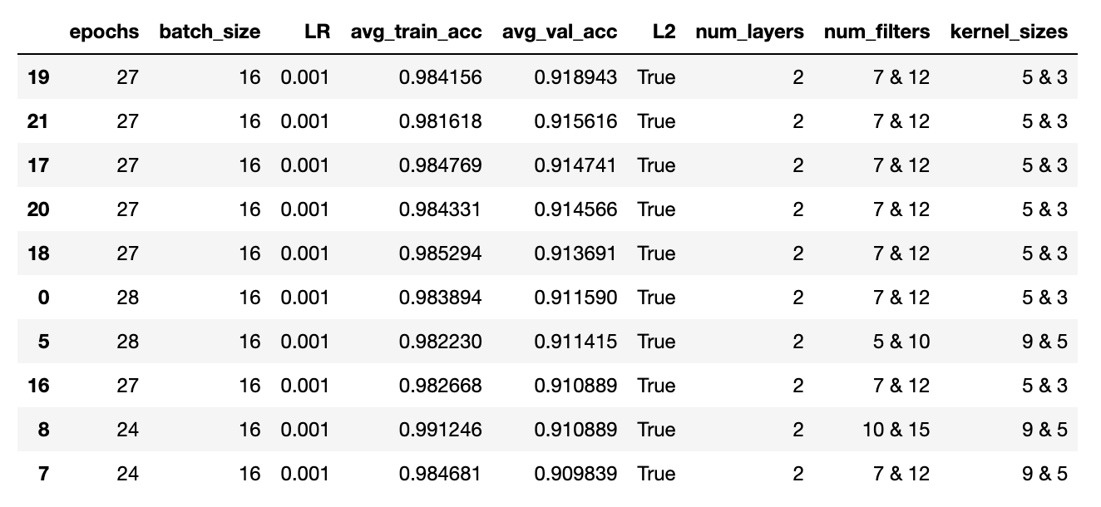
My Other Versions of CNN

Slide 12
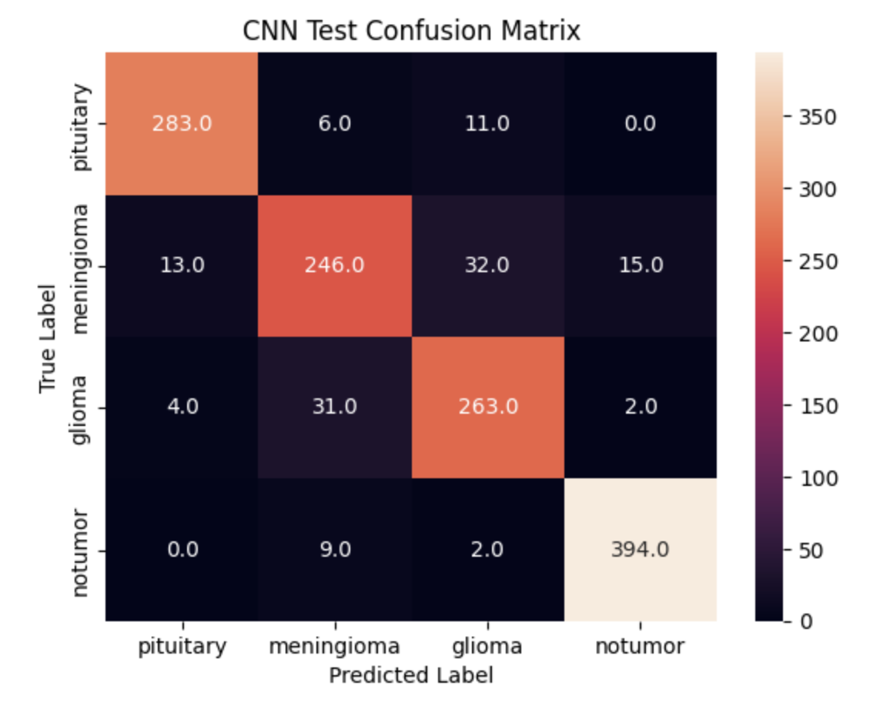
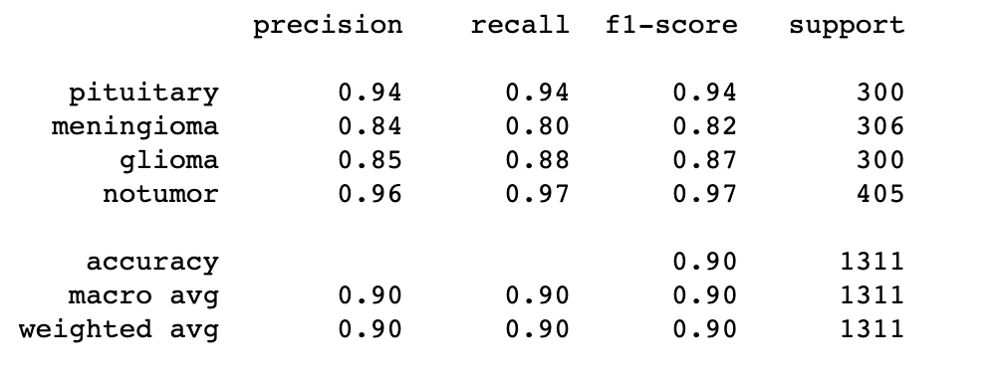
Classification Metrics on Test Dataset
Accuracy: 90.5%

Slide 13
Potential Next Steps
Trying out other established models & seeing corresponding accuracy on test dataset
Comparing current data processing method with a CNN Variational Autoencoder
Flagging potentially misclassified images:
Characterize a model unsure state as having largest 2 softmax probabilities within 10% of each other
Show radiologist the array of these images for his/her diagnosis

Slide 14
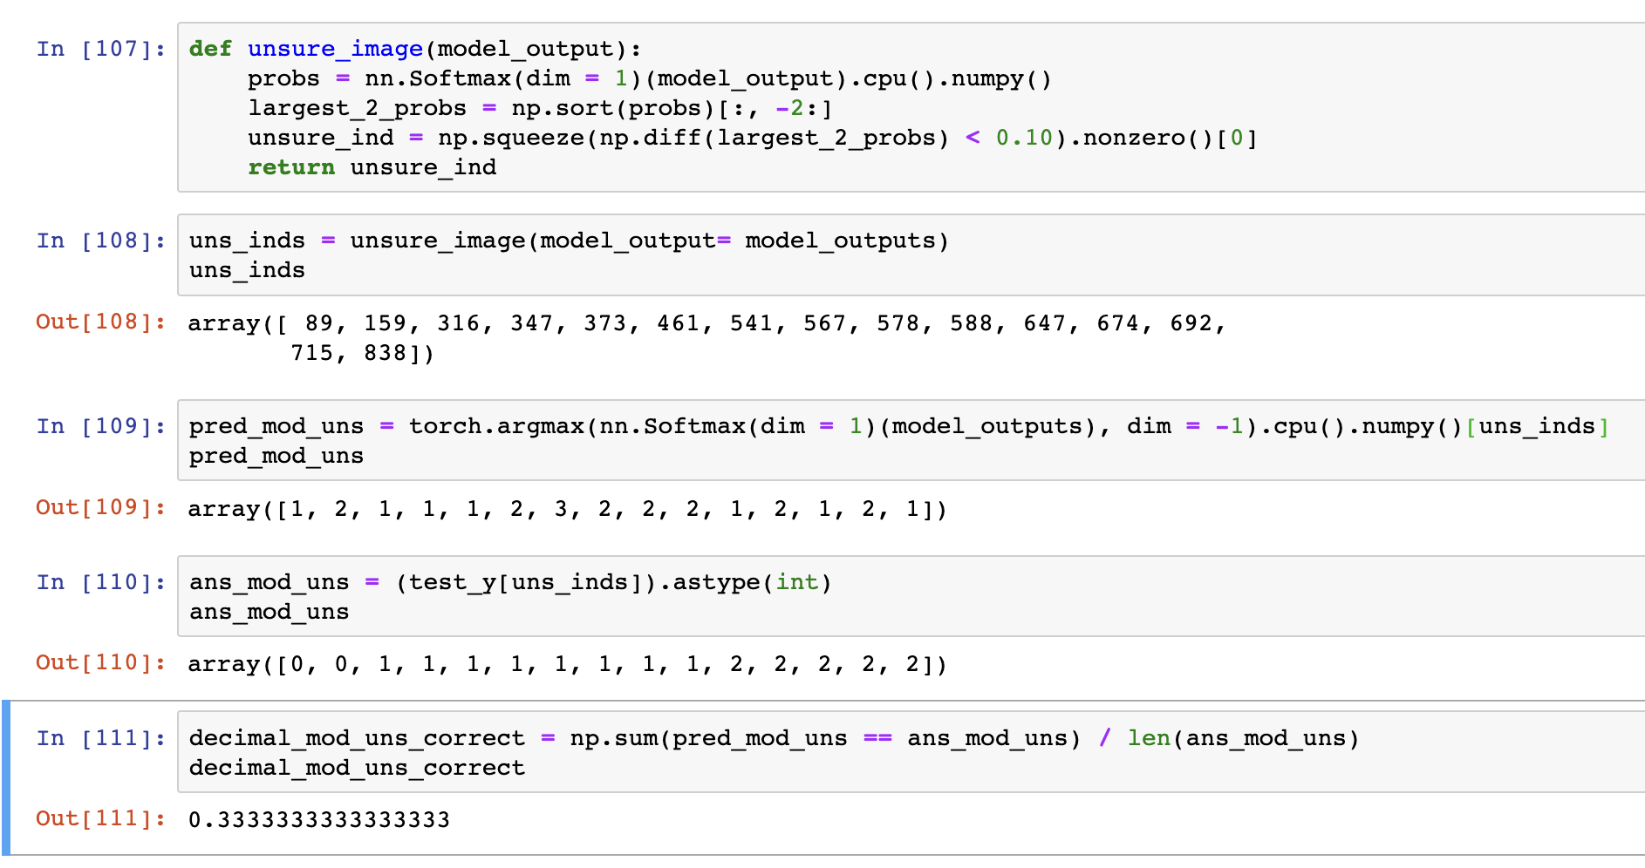
How It would Look like?

Slide 15
References
McDonald RJ, Schwartz KM, Eckel LJ, et al. The Effects of Changes in Utilization and Technological Advancements of Cross-Sectional Imaging on Radiologist Workload. Acad Radiol. Published online July 22, 2015.
Kwee, T.C., Kwee, R.M. Workload of diagnostic radiologists in the foreseeable future based on recent scientific advances: growth expectations and role of artificial intelligence. Insights Imaging 12, 88 (2021). https://doi.org/10.1186/s13244-021-01031-4

Slide 16
Questions???

